Slide 1
Income Volatility and Climate-Smart Agriculture
Sustainable agriculture in Kenyan Financial Diaries
Kyle M. Brinkman
Supervisor: Remco Oostendorp

Slide 2
Introduction
Changing climate creates volatility in agricultural yields; shorter growing seasons, less rainfall, etc.
Smallholder households are reliant on harvests for income and consumption.
CSV/CSA addresses this issue by improving practices
Financial Diaries are a longitudinal data collection method used to track transactions and household characteristics.
Measuring income volatility and conducting analysis using OLS and IV models of the effect of CSA on volatility

Slide 3
Income Volatility
Morduch, J., & Siwicki, J. (2017). In and Out of Poverty: Episodic Poverty and Income Volatility in the US Financial Diaries. Social Service Review, 91(3), 390–421.
Variation of income can have significant negative consequences for households, especially households which are already poor, or near poor.
Using Financial Diary data to identify volatility and observe smoothing (Morduch & Siwicki)
Contributing to existing literature by applying the same approach to smallholders and using econometric tools to find causal links in volatility reduction.
Applying this concept to smallholders in Nyando, Kenya, where agriculture is a key source of income.
Worsening conditions with regard to soil degradation, growing period, and droughts have led to unreliable harvests and reduced yields.
CSA practices which promote diversification, adaptation, and conservation directly address these problems and their continued uptake may help reduce volatility.

Slide 4

Portfolios of the Poor, 2009
Daryl Collins
Jonathan Morduch
Stuart Rutherford
Orlanda Ruthven
Notes:
Foundational piece of literature
What do the poor do with their money when they have so little of it?
Some assume they don’t have a financial life
Opposite is true
Bangladesh India South Africa, 300 HH

Slide 5
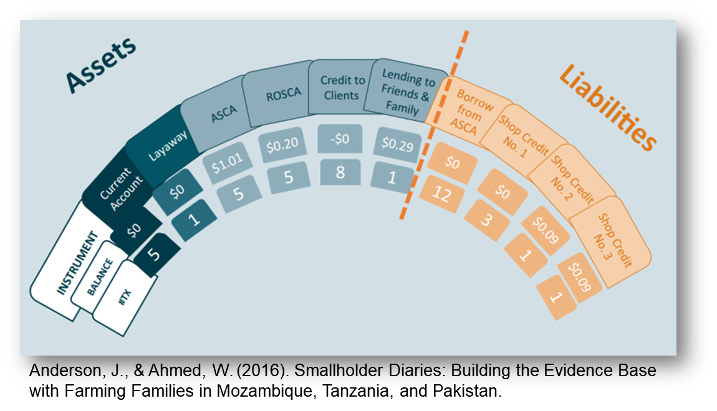
What role can Financial Diaries play?
Identifying financial instrument use
Feedback on the limitations and value of specific instruments
Observe details of financial management within a household
Describe links between individuals and value chains
Give Context to certain behaviors and management techniques
“Debt and household Finance” (2008) by Daryl Collins
“Liquid Milk: Cash Constraints and Day-to-Day Intertemporal Choice in Financial Diaries” (2017) by Geng, X., Janssens, W., & Kramer, B.
Money talks: conversations with poor households in Bangladesh about managing money (2002) by Stuart Rutherford

Slide 6
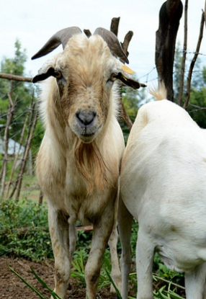
CSA
Climate-Smart Agriculture &
Climate-Smart Villages
Dry seasons have become more frequent and intense, effects of pests and disease have increased, and continued poverty and lack of diversification has made households more vulnerable to risks (Aggarwal et al., 2018).
Agriculture is main source of livelihood providing food and income in Nyando. Takes form in largely subsistence rain-fed mixed crop-livestock. Risks related to climate include frequent droughts, increasingly unpredictable rainfall patterns, flooding in lower areas, agricultural water shortages and heat stress
Practices including diversification of crops, introducing drought resistant varieties, and other methods can help resilience to these vulnerabilities

Slide 7
Methods
Descriptive Analysis
Explanatory Analysis
Calculating monthly income volatility by household
Tracking the duration of poverty in each household
Setting poverty threshold of the sample
IV estimation and OLS estimation of CSA use on Volatility
Instrumenting CSA use with CSV participation; CSV as the intent-to-treat, and CSA participation to measure effect of treatment effect on the treated.
Conducting Tests for relevance and weak instruments
Estimating household characteristic effects on CSA use
Data used is from the Climate-smart Financial Diaries for Scaling in Kenya project, part of the CCAFS intervention in Nyando Basin, part of the CGIAR Research Program

Slide 8
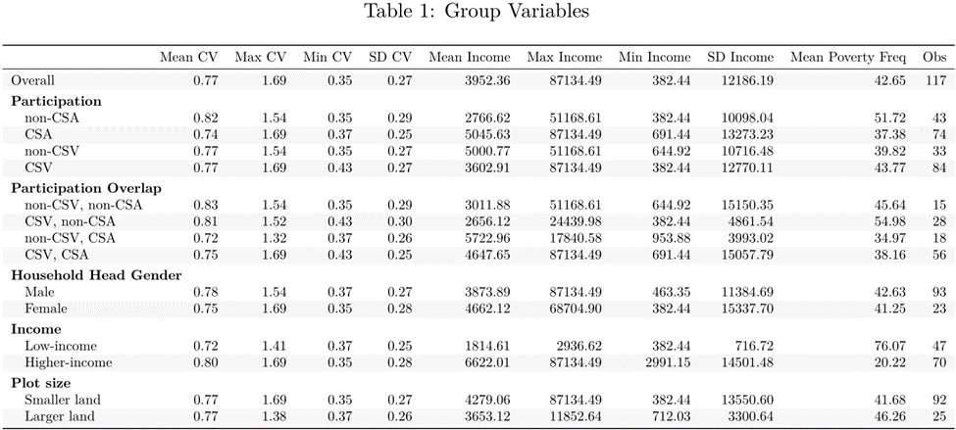
Descriptive Statistics
Notes:
Accuracy of FDs

Slide 9
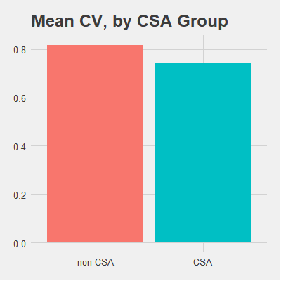
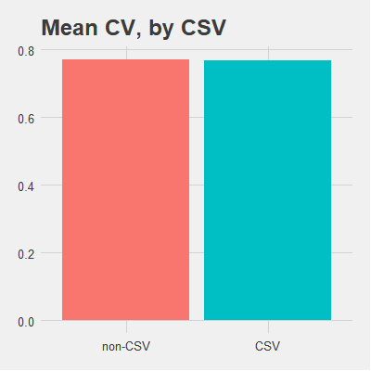
Income Volatility

Slide 10
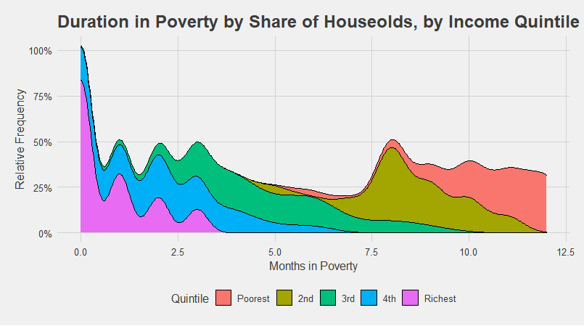
Poverty Persistence
Frequency of poverty within a household over the duration of a year
When income volatility is high, households which are at or near poverty may consistently drop to income levels below the poverty threshold.
Higher income households can often smooth their incomes through savings or borrowing
In the case of smallholders, households rely on harvests not only for income but for their own consumption.
Most households at one point or another go below the poverty threshold.
This shows a prevalence of episodic poverty at higher quintiles, while persistent poverty is abundant in lower quintiles.

Slide 11
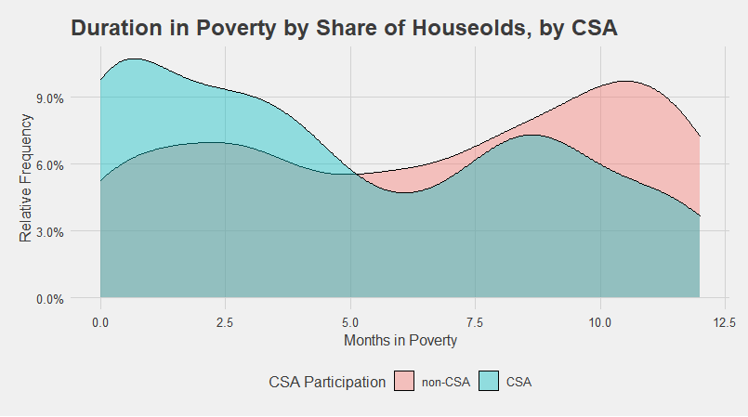
CSA and Poverty Persistence
Notes:
Accuracy of FDs

Slide 12
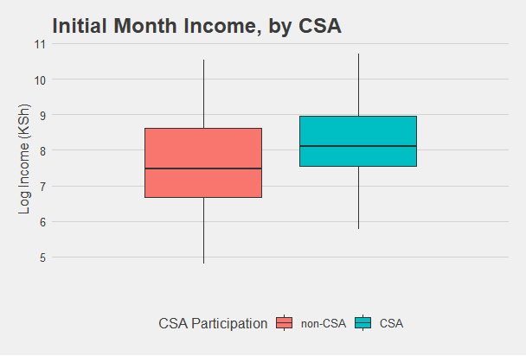
Participation in CSA
Sample Characteristics
118 Households are used for analysis across four participation groups between CSV and CSA use
First-month incomes for households which applied CSA practices during the study had higher mean incomes.

Slide 13
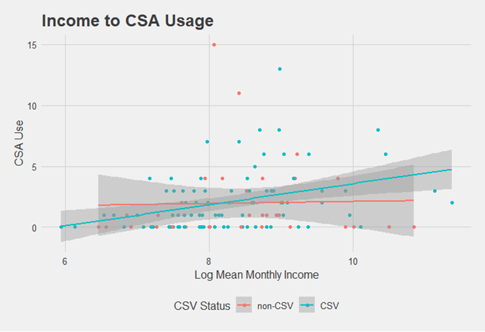
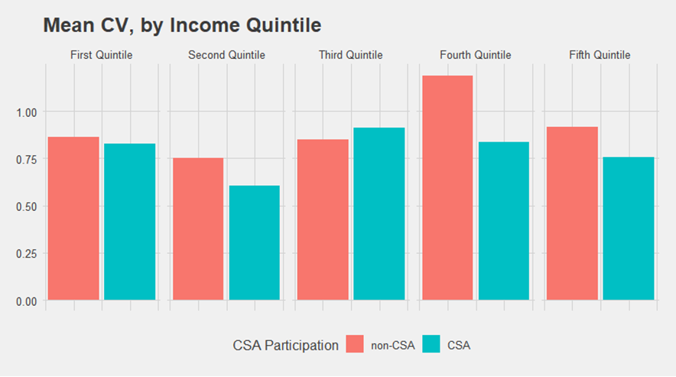
Further Breakdowns
Effects of Income

Slide 14
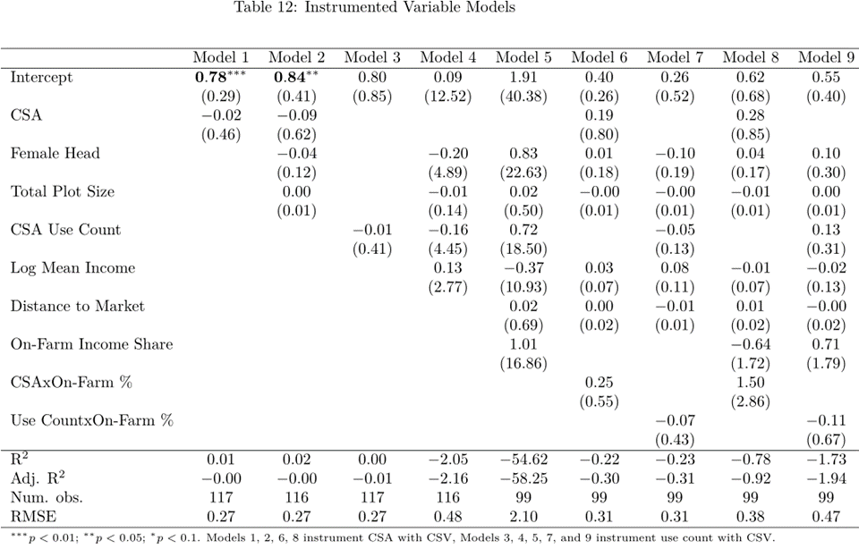
IV: CSA Use on Income Volatility
Notes:
Accuracy of FDs

Slide 15
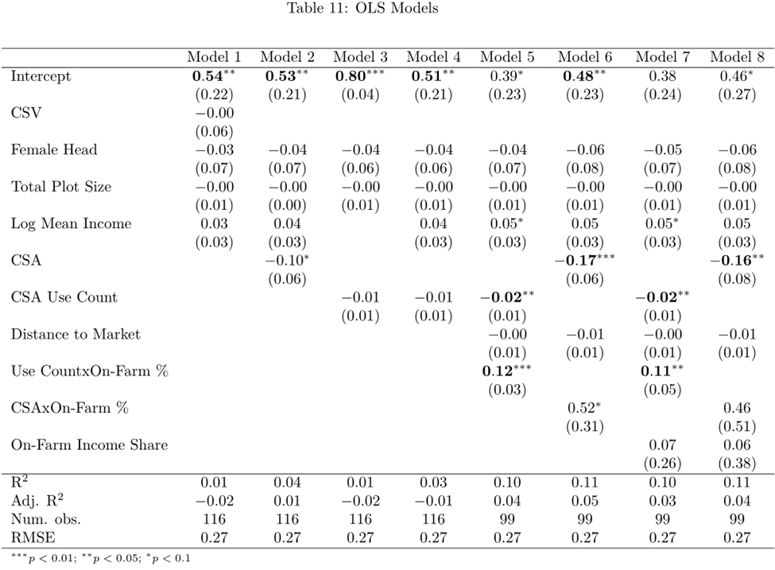
OLS: CSA Use on Income Volatility
Notes:
Accuracy of FDs

Slide 16
Conclusion
Findings
Recommendations Further Study
CSA use is effective in reducing income volatility
Endogeneity issues in regression model
Effects of initial income, past CSA use, and response to volatility
Low- income and female headed households have significantly lower rates of CSA uptake
Expanding financing options to these groups would likely improve incomes for these groups
Using CV to measure volatility has its issues

